Slide 1


MYNTRA ANALYSIS

Slide 2


About Myntra
Myntra is one of the largest fashion eCommerce stores in India that deals with a wide range of fashion and lifestyle products for men, women, and kids.
In 2007, Vineet Saxena, Mukesh Bansal, and Ashutosh Lawania established Myntra.
Myntra sold on-demand personalized gift items initially.

Slide 3
MISSION & VISION

Slide 4

Myntra's mission and vision are to provide "a hassle-free and enjoyable shopping experience to shoppers across the country with the widest range of brands and products on its portal."

Slide 5
BUSINESS MODEL

Slide 6

"Business to customer" marketplace model, where it allows multiple businesses to sell their products on its platform. Myntra's business model includes the following:
Inventory management :Myntra uses real-time tracking, centralized fulfillment centers, and data-driven demand forecasting to manage stock levels.
Seller models :Myntra offers two main seller models: PPMP (Pure Play Marketplace) and MSA. In PPMP, the seller stores and packs their products, while Myntra handles logistics. Myntra also has JIT and FBM models, where Myntra issues a bulk purchase order or stock transfer order to the seller.
Commission : Myntra charges a flat commission of around 4-5% per product, depending on the brand and product category. The commission is lower for low-price and high-value products, and higher for ethnic and Western apparel.
Features :Myntra offers features like "Virtual Try-On" and exclusive capsule collections.

Slide 7
GROWTH & MARKET SHARE

Slide 8
Growth
Myntra's operating revenue increased in financial year 2023, and the platform has been growing faster than the online fashion market since the second half of 2023.
Market share
Myntra has the highest market share in terms of active user in the fashion e-commerce segment.
Customer base
Myntra's monthly active users (MAUs) increased by 33% from 45 million in 2021 to 60 million by the end of 2023.
It has 60 million average users as of March 2024
It has delivered to over 19,000 pin codes across India as of March 2024
Catalog size
The catalog size on the platform has grown by over 50% in the last year.
The company has over 6,000 brands as of March 2024
Myntra has over 400 international brands in its portfolio, including Mango, H&M, and Tommy Hilfiger.

Slide 9
REVENUE MODEL

Slide 10
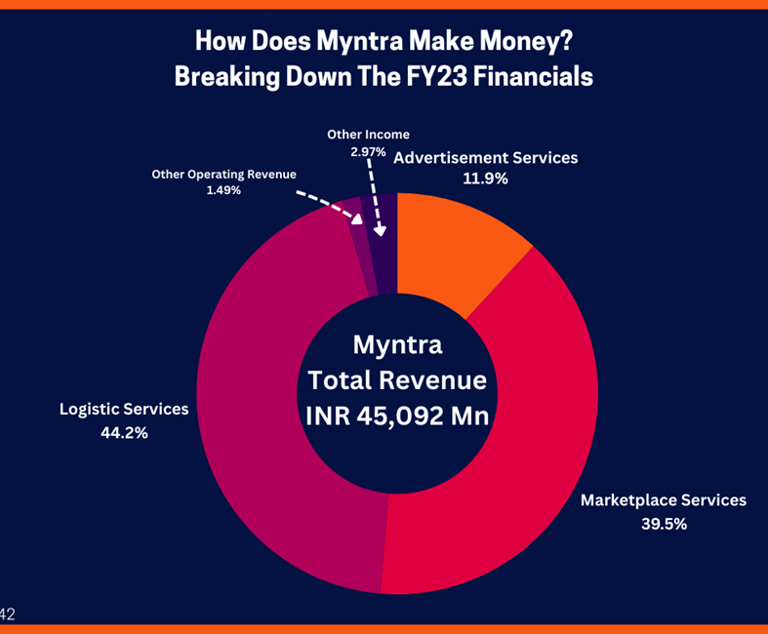
Commission Fees: Depending on the product's category and brand, Myntra's primary revenue stream is the charging of a predetermined fee, which normally ranges from 4% to 5%.
Marketplace Services: Myntra makes money by giving different brands and merchants a place to display and sell their goods on its online marketplace.
Logistics Services: By making it easier for clients to store, package, and receive things, the company makes money through its logistics services.
Advertisement: Myntra makes use of its platform to facilitate the promotion of brands' items to a broad audience, generating extra income.

Slide 11
MYNTRA FINANCIALS | FY22 | FY23
Operating Revenue | INR 3501.2 Crore | INR 4375.3 Crore
Total Expenses | INR 4206.9 Crore | INR 5290.1 Crore
Cost Of Material Consumed | INR 1770.3 Crore | INR 2165.7 Crore
Employee Benefit Expenses | INR 522.5 Crore | INR 634.8 Crore
Advertising Expenses | INR 1298 Crore | INR 1758.8 Crore
Net Loss / Profit | Loss of INR 597.6 Crore | Loss of INR 782.4 Crore

Slide 12
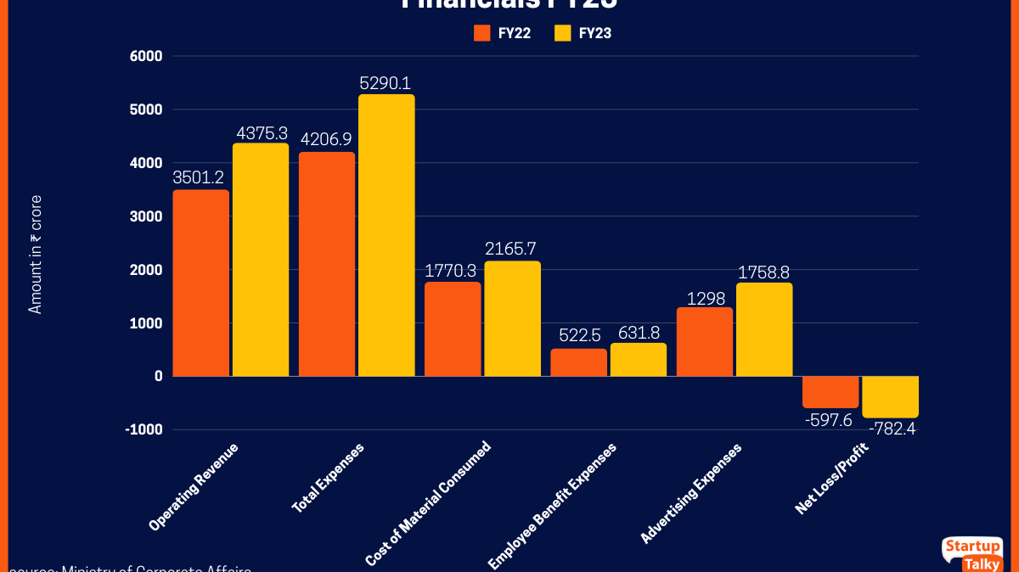

Slide 13
TECHNOLOGY ANALYSIS

Slide 14

Technology is central to Myntra’s innovative and differentiated shopping experience.
Focus on enhancing customer satisfaction through technology-led innovations.
Curated app-in-app experiences (FWD, Luxe, Beauty), personalized recommendation widgets, MyStylist, GenAI features like MyFashionGPT & Maya.
Virtual try-ons for apparel/beauty, skin analyzer for product recommendations.
Myntra Minis – short-form videos for fashion inspiration.
UPI, BNPL, co-branded credit cards, and delayed payment options.
AI & GenAI: Applied in fashion design, customer support, and creative automation.
AR/VR: Virtual try-ons, enhanced product visualization.
Blockchain: Transparency and trust-building in the supply chain.

Slide 15
FUTURE PLANS

Slide 16

Myntra's goals for the future are to propel expansion, innovation, and client happiness in the dynamic field of fashion eCommerce.
Myntra will be able to open NEXT-branded stores all over India, increasing its omni-channel footprint and product choices.

Slide 17
SWOT ANALYSIS

Slide 18
Strength
Diverse inventory with 5000+ locations national wide
Efficienct Supply network reaches 90000+ locations national wide
Reliable tech and user interface
Features include visual search and virtual trial rooms powered by augmented reality
Weakness
Rivals like Jabong, Amazon, Ajio and Meesho
Dependence on Discounts
Opportunities
Financial gains from increased private labor sales
Bridal market in India is ripe for exploration
Leverage parent company Flipkarts network for increased exposure and sales
Threats
Dependency on Third-Party Logistics:
Amazon's formidable reputation and massive customer base

Slide 19
CUSTOMER ANALYSIS from Trust Piolet using CHATGPT

Slide 20
HIGH IMAPCT CUSTOMER REVIEWS
Product Quality:
Implement a rigorous quality control process at all stages of production and shipping.
Conduct regular audits of suppliers to ensure they meet quality standards.
Delivery and Logistics:
Invest in advanced logistics technology to optimize routes and improve tracking.
Partner with reliable delivery service providers with a strong track record.
Implement a robust system for handling returns and exchanges.
Return and Exchange:
Clearly communicate return policies and procedures to customers.
Streamline the return process and provide easy-to-follow instructions.
Ensure timely processing of returns and refunds.
Customer Service:
Provide comprehensive training to customer service representatives on product knowledge, problem-solving, and empathy.
Implement a system for tracking and addressing customer complaints.
Offer multiple channels of communication, such as phone, email, and chat.
Misleading Marketing:
Ensure that product descriptions and images accurately reflect the actual product.
Avoid deceptive pricing practices or misleading promotions.

Slide 21
MEDIUM IMAPCT CUSTOMER REVIEWS
Limited Product Selection:
Conduct market research to identify customer preferences and expand product offerings accordingly.
Partner with more brands and suppliers to increase product variety.
Website and App Glitches:
Regularly update and maintain the website and app to ensure optimal performance.
Conduct thorough testing before launching new features or updates.

Slide 22
LOW IMAPCT CUSTOMER REVIEWS
Personal Preferences:
Consider incorporating customer feedback into product development and design.
Positive Experiences:
Recognize and reward employees for exceptional customer service.
Encourage customers to share their positive experiences through reviews and social media.

Slide 23
MARKETING STRATERGY

Slide 24
Content Marketing : Myntra is to maintain an active blog for its content marketing strategy that covers a wide range of fashion trends and fashion-related topics. This blog contains multiple sources, which creates an audience segment while broadening its appeal.
Social Media Marketing : Myntra's social media strategy includes creating an active presence on all the major social media platforms, such as Instagram, Twitter, and Facebook. Therefore, this allows Myntra to promote discounts on new products and announce sales from time to time.
Paid Advertising : To promote the business website and products which combines both paid and organic sources of marketing to reach a broad audience for its brand. Ad extensions like product listing to make their ad more informative and relevant for better potential customer reach.
Email Marketing : Myntra business uses an email marketing strategy to make connections to reach a wide range of customers and announce new discounts or sales announcements.
Affiliate marketing strategy : Myntra business offers different athlete programs like the Myntra partner program, which provides a commission for every sale generated.
Myntra Business SEO strategy : Myntra also uses SEO as your key component to create a marketing approach. They use phrases and keywords in their site content to ensure that their website ranks high in results.

Slide 25
COMPETITIVE ANALYSIS

Slide 26
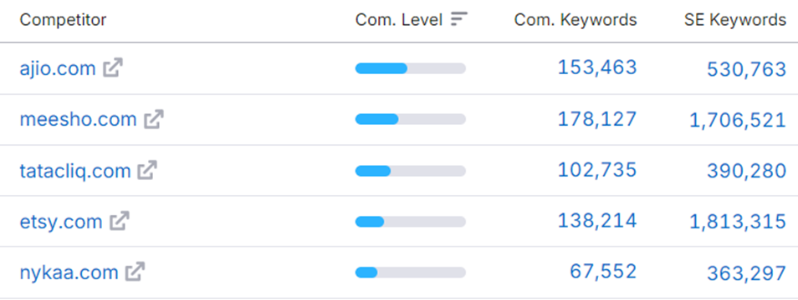
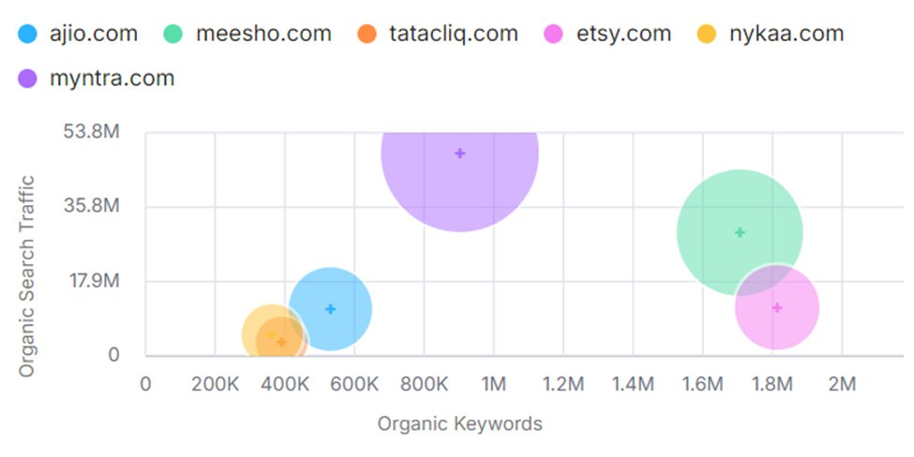
Main Organic Competitors & Positioning Map

Slide 27

Comparison Factors
Product Range and Variety: The breadth and depth of product offerings, including brands, categories, and styles.
Pricing and Discounts: The pricing strategy, including discounts, offers, and value for money.
User Experience: The ease of navigation, website design, and overall shopping experience.
Delivery and Logistics: The speed, efficiency, and reliability of delivery services.
Customer Service: The quality and responsiveness of customer support.
Brand Partnerships and Exclusivity: The ability to offer exclusive brands or collections.
Marketing and Promotions: The effectiveness of marketing campaigns and promotions.
Mobile App Experience: The quality and features of the mobile app.

Slide 28
Competitive Advantage
Strong Brand Recognition: Myntra has established a strong brand identity and recognition among Indian consumers.
Curated Collection: It offers a curated collection of fashion products, focusing on quality and trendiness.
Exclusive Partnerships: Myntra has partnered with several international and Indian brands to offer exclusive products.
Fashion-Forward Approach: Myntra positions itself as a fashion-forward platform, catering to the latest trends and styles.
Strong Online Presence: It has a well-developed website and mobile app, providing a seamless shopping experience.
Effective Marketing Campaigns: Myntra invests in marketing and promotions to reach a wide audience and drive sales.

Slide 29
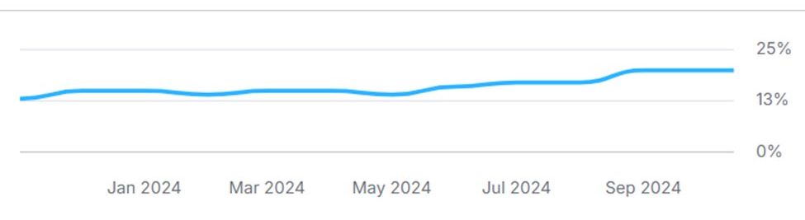
BRAND TRAFFIC TREND OF MYNTRA YEAR ON YEAR

Slide 30
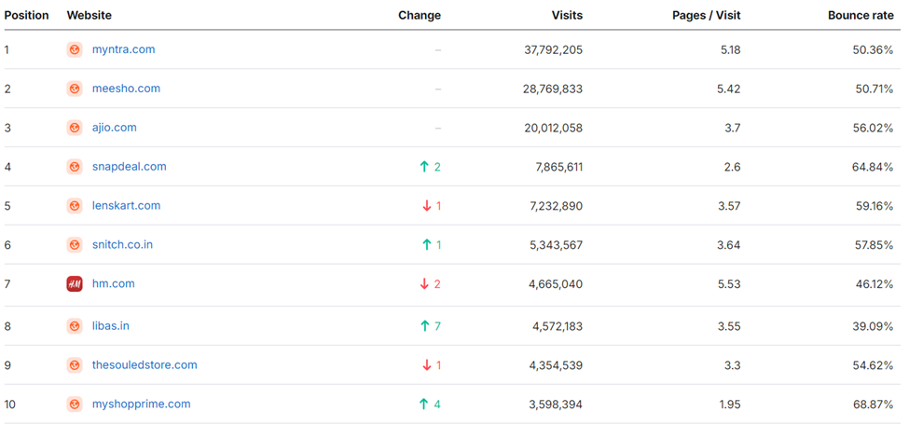
BRAND TRAFFIC ANALYSIS

Slide 31
STRATEGIC RECOMMENDATION

Slide 32
Strengthen Product Quality and Accuracy
Improve Delivery and Logistics
Enhance Customer Service
Expand Product Offerings
Leverage Technology
Strengthen Brand Identity
. Prioritize Sustainability

Slide 33
WEBSITES USED FOR ANALYSIS

Slide 34

Competitors and web traffic – www.similarweb.com
Competitor Analysis – www.semrush.com
Revenue Details – www.dealroom.com
Statistics & Revenue Data – www.statista.com
Customer feedback – www.trustpiolt.com , www.kimola.com

